Slide 1
Operationalizing Infrastructure
Hands-On Challenge

Slide 2
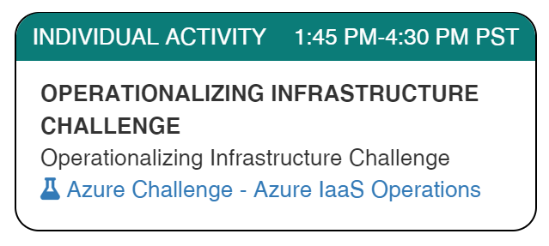
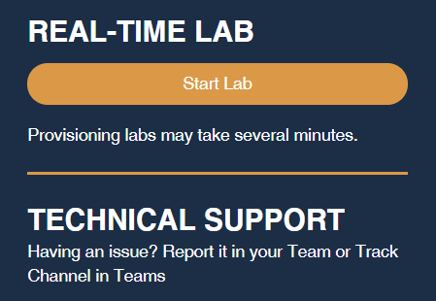
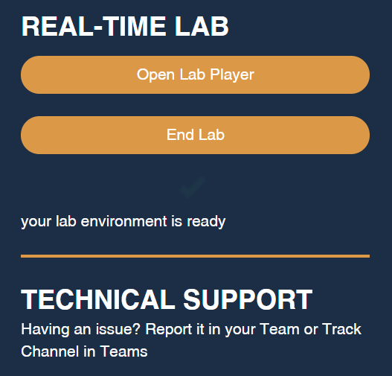
Launch the Lab Environment
Important! Allow at least 1 hour for your lab to start

Slide 3
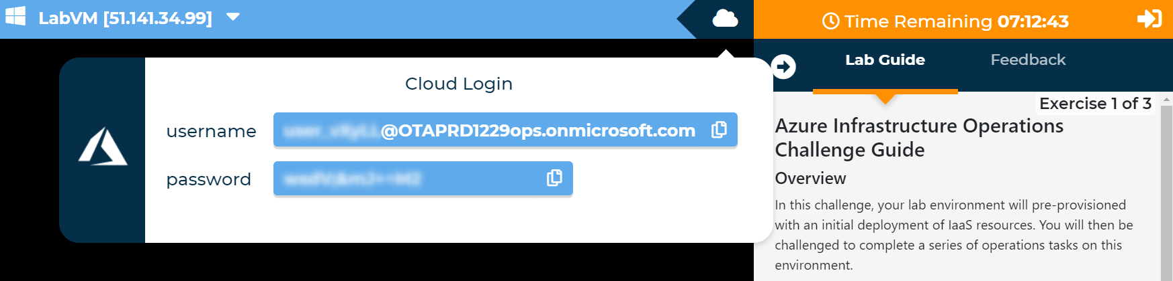
Access Your Lab
Important! Allow at least 1 hour for your lab to start

Slide 4
Challenges
Challenge 1: Automatic On-Boarding to VM Insights
Scoped to resource group (for security reasons)
Challenge 2: Resource Graph Explorer
Creating a non-trivial Resource Graph query
Challenge 3: Azure Monitor Workbooks
Explore Workbook features – feel free to do more than asked!
Note Automatic validation of your solution has been disabled to speed up the lab for you
Notes:
In this challenge, your lab environment will pre-provisioned with an initial deployment of IaaS resources. You will then be challenged to complete a series of operations tasks on this environment.
These include configuring the 'VM Insights' solution and enabling automatic enrollment of virtual machines, using Azure Resource Graph to explore the deployed resources, and building an Azure Monitor Workbook.
The lab will not validate that each challenge has been completed correctly, so pay close attention to the requirements in each challenge.

Slide 5
Need help?
Use the Teams chat channel
Solutions will be given in tomorrow morning's kick-off session

